Slide 1
SG9000 Standard OS
Arkhan

Slide 2
Agenda
Introduction of GUI
Procedure of Testing
Setting
Structure of Testing Program
Testing Function

Slide 3
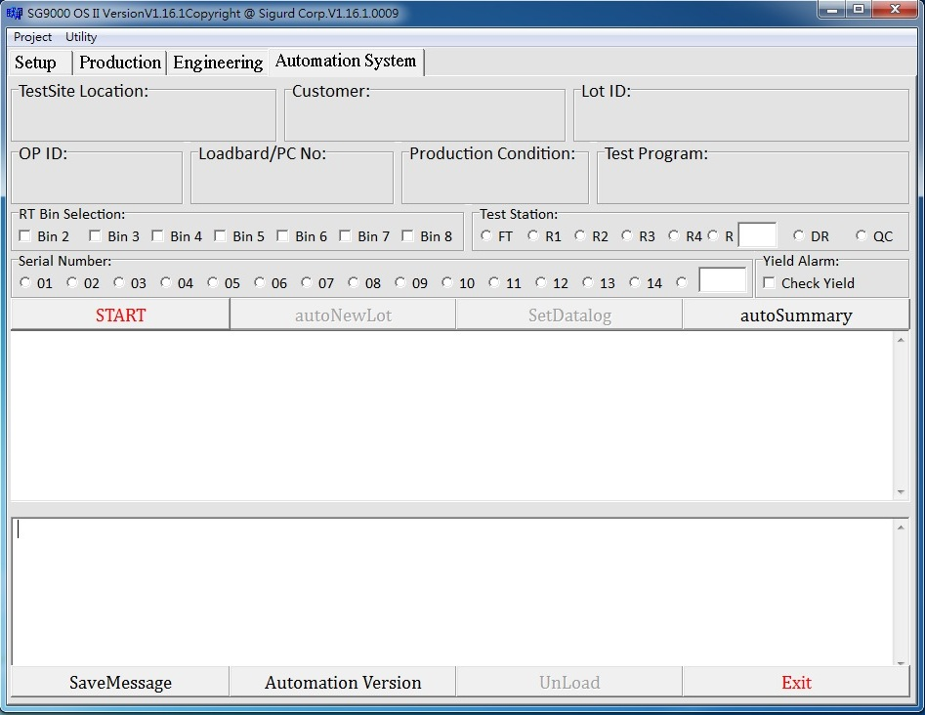
Introduction of GUI – Auto Load

Slide 4
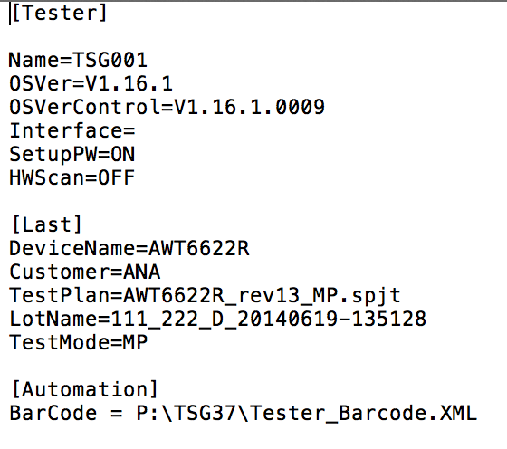
Setting of Auto Load
SG9000.ini,BarCode
Setup File
Zipped Test Program File
SG9000.INI
SETUP FILE

Slide 5
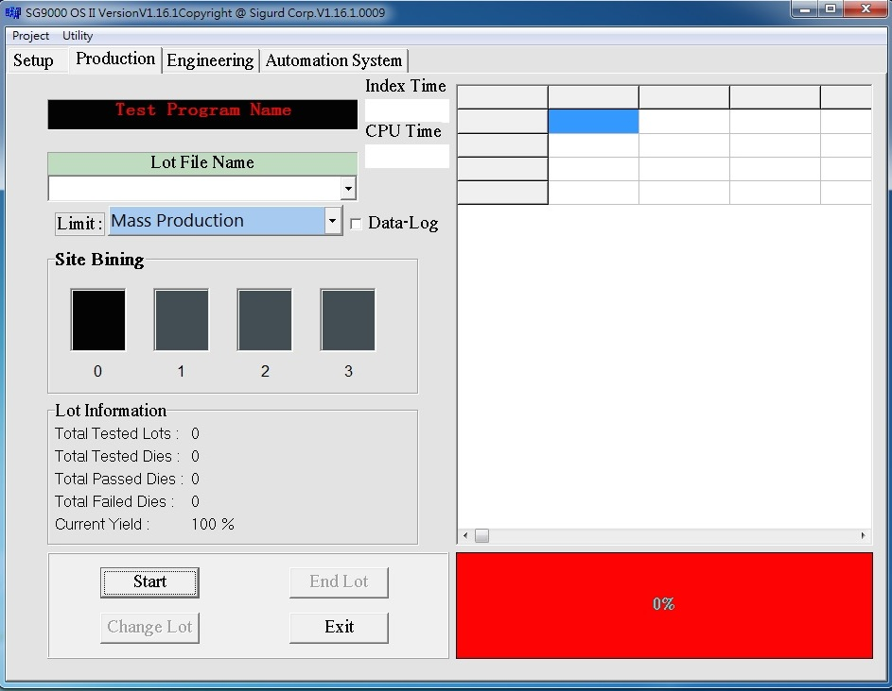
Introduction of GUI - Production

Slide 6
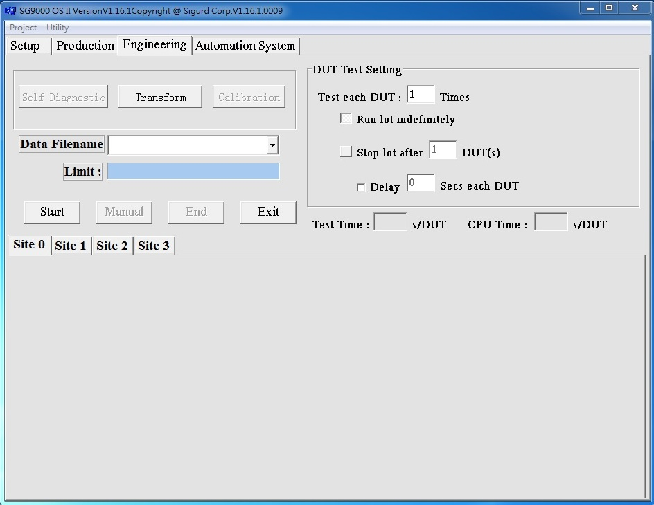
Introduction of GUI - Engineering

Slide 7
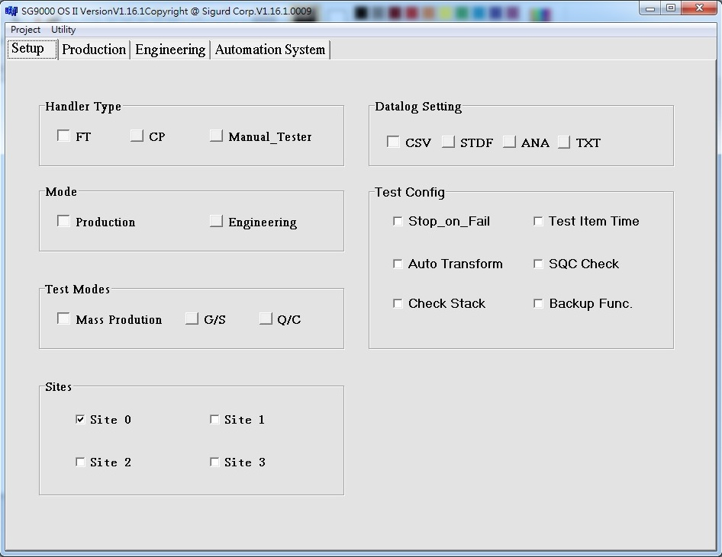
Introduction of GUI - Setup

Slide 8
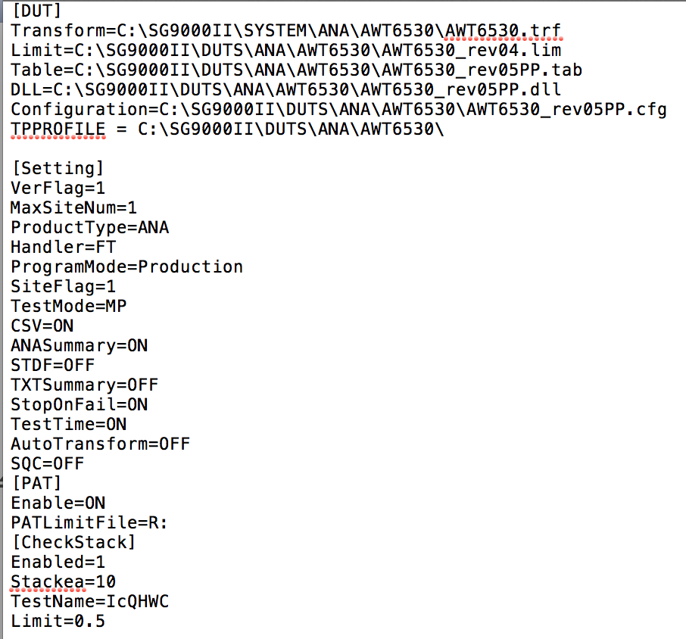
Relationship of SPJT and Setup

Slide 9
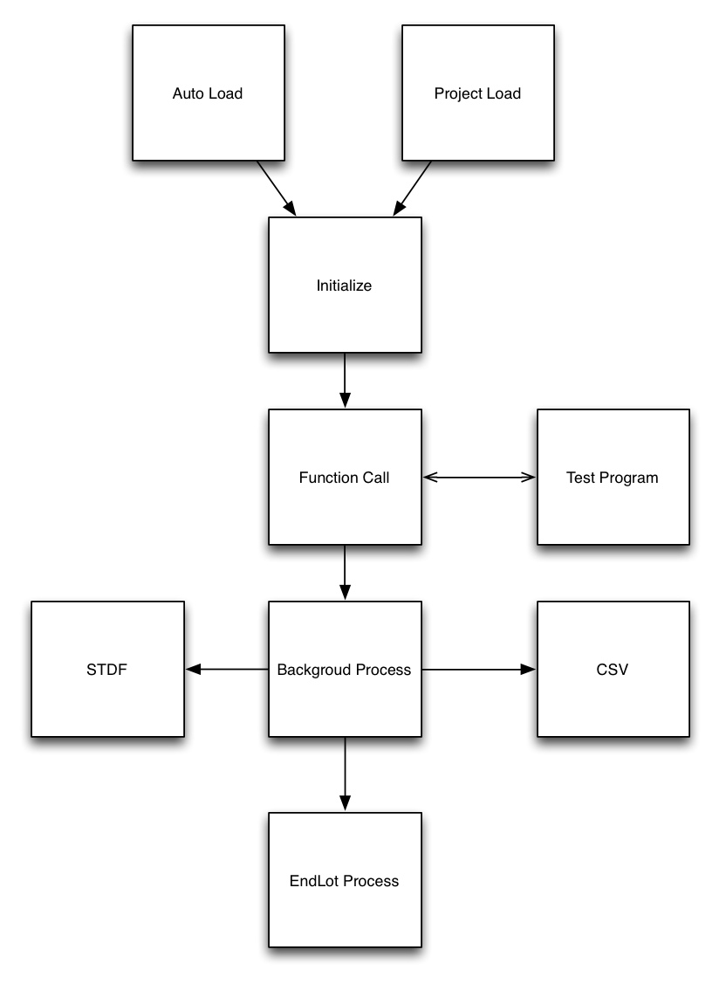
Procedure of Testing

Slide 10
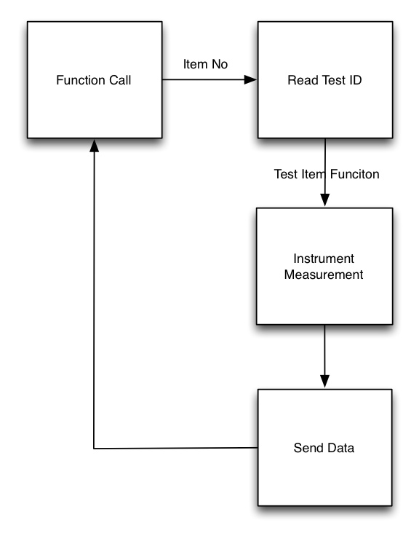
Structure of Testing

Slide 11
Structure of Testing
File Type of Test Program
Test Item File (.tab)
Limit File (.lim)
Test Program File (.cpp)
Project File (.spjt)

Slide 12
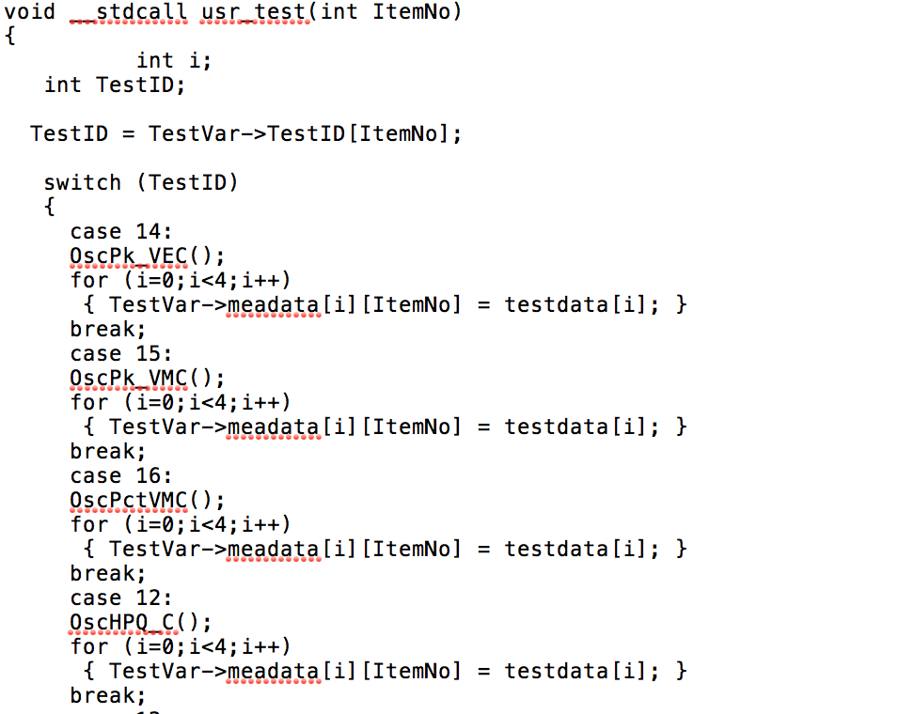
Structure of Testing
Test Funciton:

Slide 13
Directories of OS
Required directories for OS
INCLUDE
UTILITY
Directories for Production
DATALOG
DUTS
LSR
TMP
SYSTEM

Slide 14
Testing Function
Auto Transform
Stop on Fail
SQC Check
Test Time
Check Stack
PAT
AutoEndLot

Slide 15
Testing Function – Auto Transform
Calculate transform values automatically when run G/S procedure.
To use this function you need:
Tp_profile (XXXX_GU_bench_XXXXX.txt)
tp_profile record the base line data of G/S, OS will calculate values from the file and the G/S result.
Golden Parts
Transform file (.trf)
the .trf file record calculated transform values and set which test item need to be add transform.

Slide 16
Testing Function – Stop on Fail
Stop on Fail: Stop part testing procedure if test item fail.
Set option on
Set the item which need stop on fail in tab file

Slide 17
Testing Function – SQC Check
SQC procedure is to monitor the lot if yield of monitor binning was abnormal. SQC only execute in Production Mode.
To use SQC procedure:
Set SQC on
Create SQC File to set the monitor condition

Slide 18
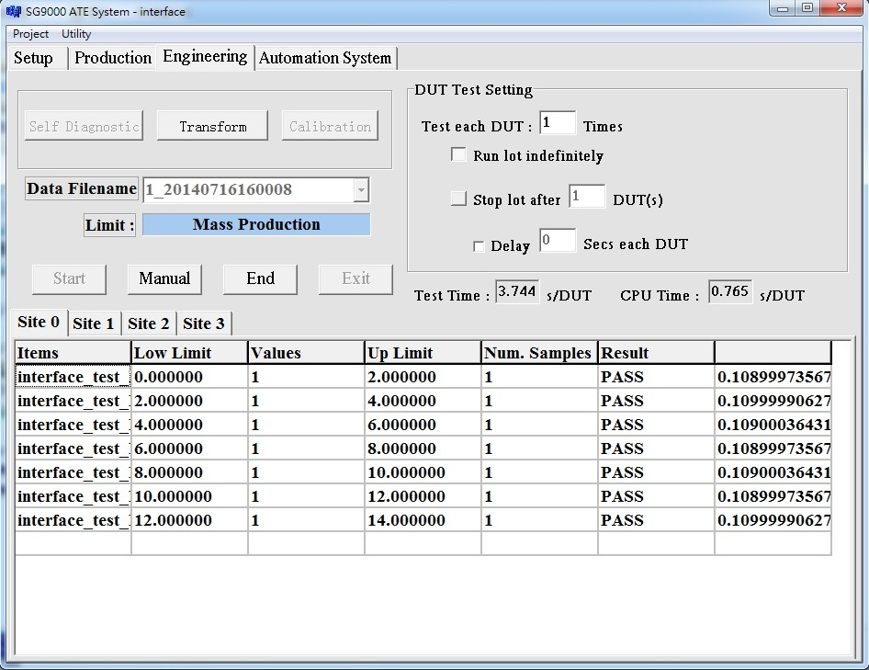
Testing Function – Test Time
The Test Time option will calculate the time each test item spend.
When test time option set on, OS will show each test item time in engineer mode.
Also record cpu time in datalog file (csv)

Slide 19
Testing Function – Check Stack
Check stack is for monitor handler if the DUT stack in production.
To set Check Stack:
Set option on
Set monitor item and limit in SPJT file
When monitor condition is reach, OS will stop and pop up alarm message.

Slide 20
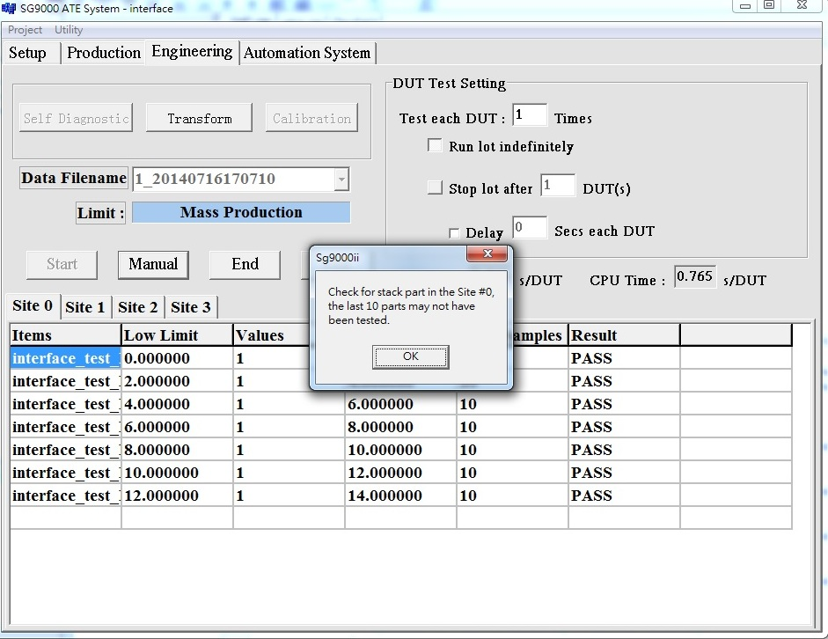
Testing Function – Check Stack

Slide 21
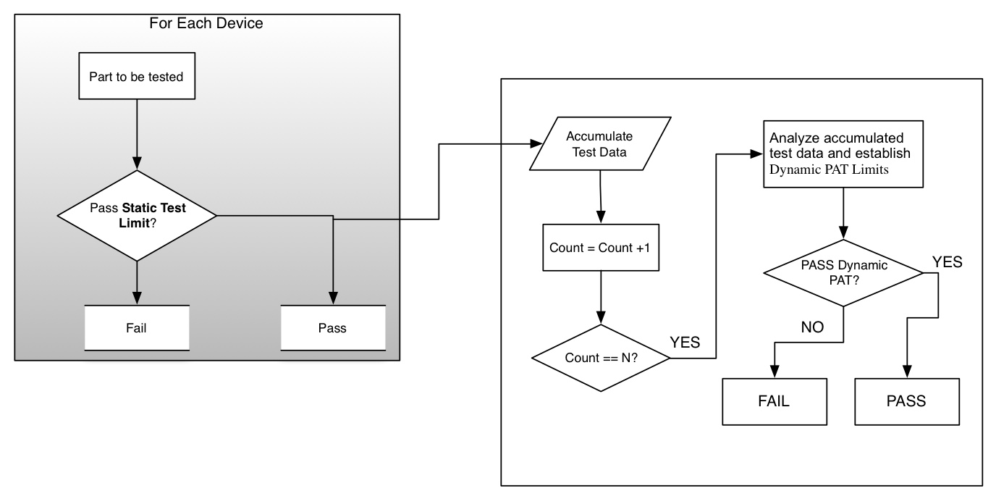
Testing Function – PAT
Part Average Test:

Slide 22
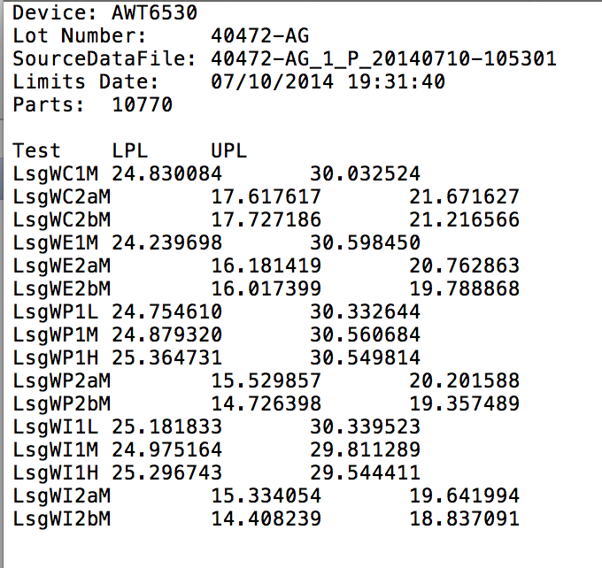
Testing Function – PAT
To activate PAT:
Set option on in SPJT
Set location of PAT limit file in SPJT
Set which item need PAT in TAB file

Slide 23
Auto EndLot
Auto Endlot procedure is to execute customize program in End Lot procedure. The customize procedure have to be build as .exe file or .BAT file so that can be execute as external function.
To run the customize program automatically:
Add the executable filename in “EndLot.txt” file. Each program list as a line.
Put the EndLot.txt file in “SYSTEM” directory

